Slide 1



Analyzing Behavioral Patterns for Enhanced Writing Quality Assessment

Slide 2



Have you ever wondered if those small actions, pauses, and revisions
could be the key to enhance writing quality?

Slide 3



Problem Statement
Does typing behavior effect the outcome of an essay?

Slide 4
OBJECTIVE
To uncover and clarify the connections between different writing processes and the quality of written content.
Focus on fostering better writing practices by clarifying how each writing process influences the overall quality of written content.

Slide 5



Data Source and Distribution
01
The dataset is taken from Kaggle .
Large dataset of keystroke logs capturing writing process features.
02

Slide 6
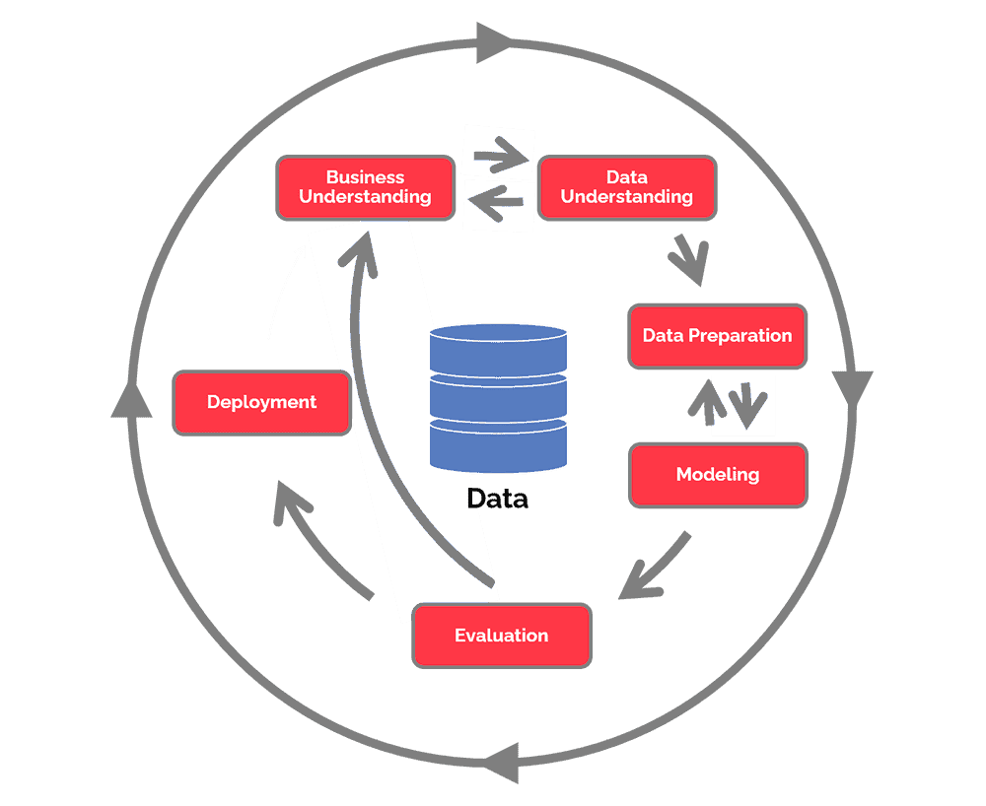
CRISP METHODOLOGY

Slide 7

BUSINESS UNDERSTANDING
Why do we care ?
Empowering Intelligent Tutoring and grading Systems
Supporting educational institutions in optimizing teaching methods.
Enhancing students' writing skills and learning outcomes.

Slide 8
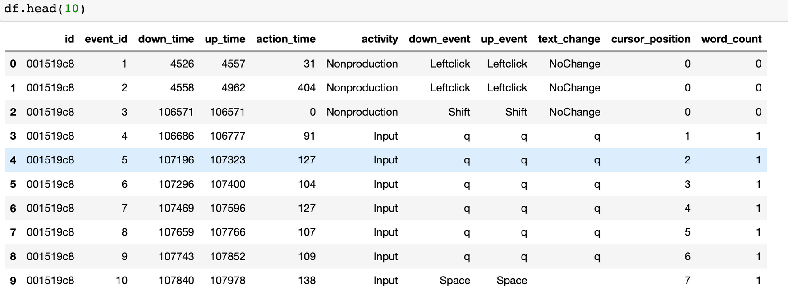
DATA UNDERSTANDING

Slide 9





Feature Engineering
Data Augmentation
DATA PREPARATION
Data Transformation
Data Cleaning

Slide 10
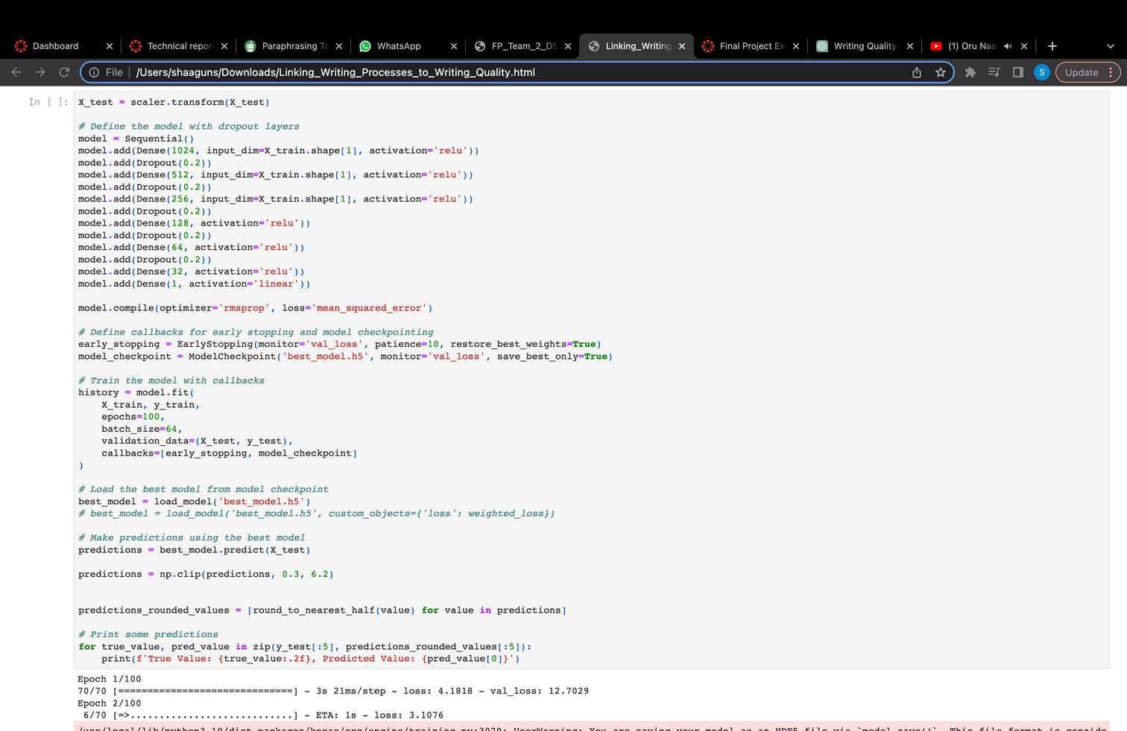
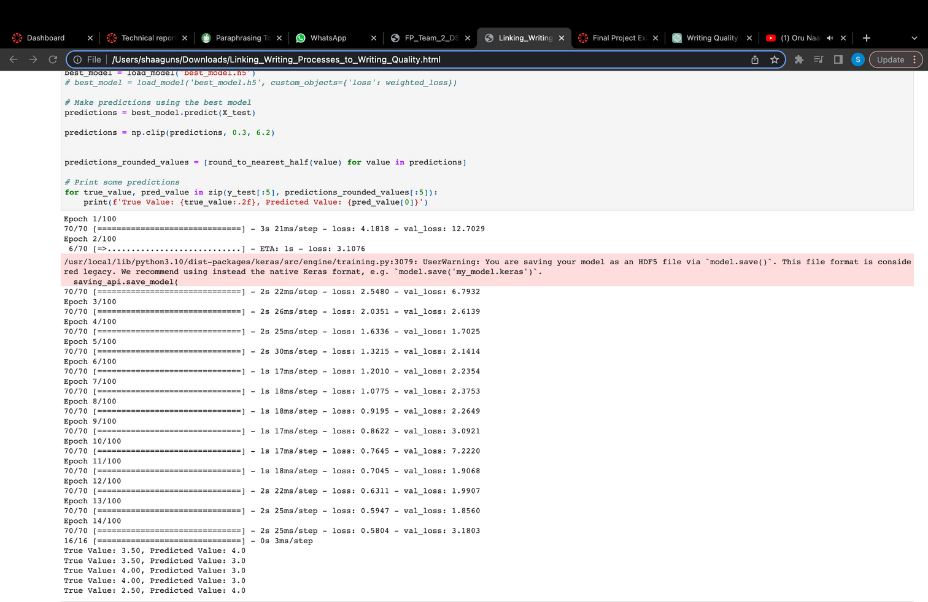
Modeling
Neural network, more precisely, sequential model is being used for Modeling.
The Sequential model organizes layers in a linear stack, facilitating a step-by-step flow of data through the network.

Slide 11
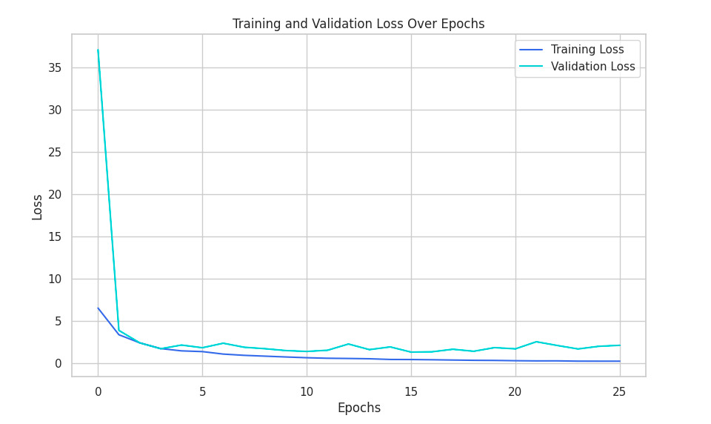
EVALUATION
Mean Squared Error is being used for evaluation .
It quantifies how close a regression line fits the data points.
Lower MSE indicates better accuracy, as it reflects smaller prediction errors.

Slide 12
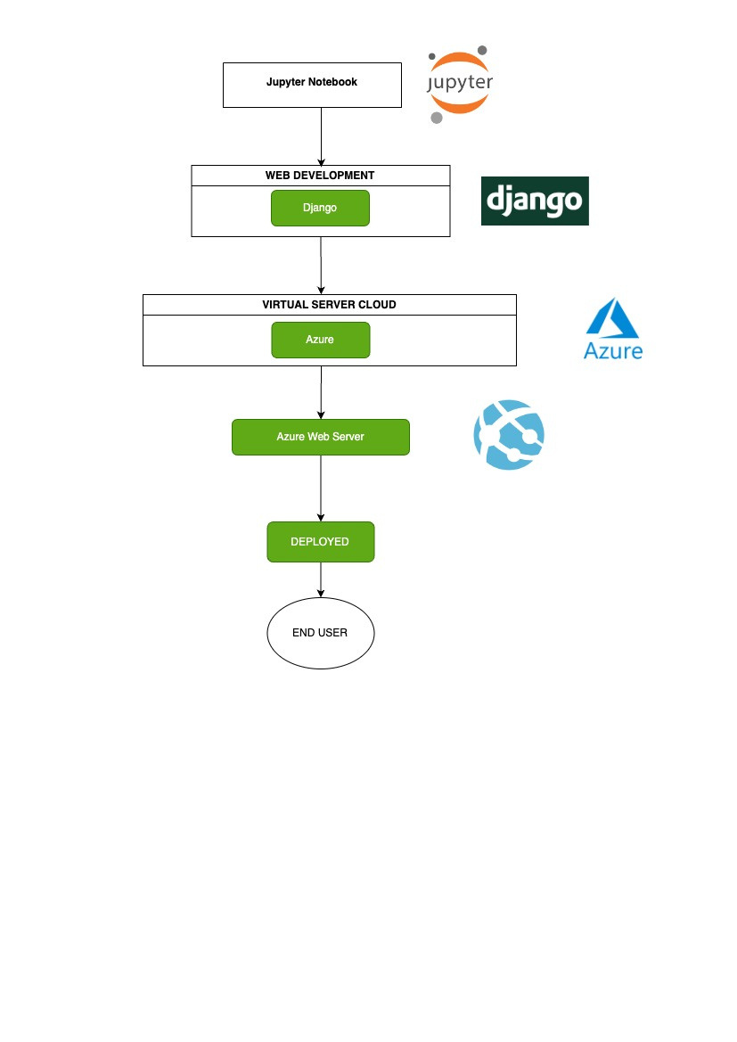
DEPLOYMENT

Slide 13


THANK YOU

